Slide 1
LECTURE – RADIACTIVE ENERGY TRANSFER
RADIATION (Chapter 8)
Explain characteristics of electromagnetic radiation – Emitted and received by a surface
Calculate the magnitude and spectra quality of electromagnetic radiation
Explain energy emitted by an ideal body (black body) and real (gray) bodies. Definition of emissivity

Slide 2
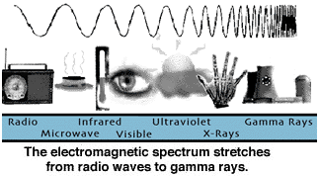
wavelength
frequency
Speed of the light
Length or time

Slide 3
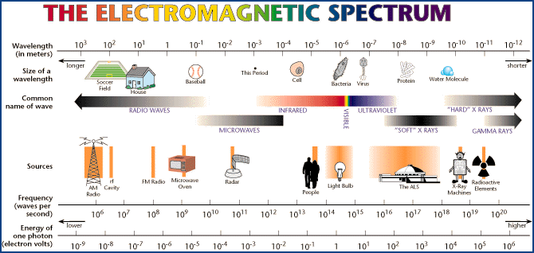
Thermal Radiation = 10⁻⁷m – 10⁻⁴m
0.1μm - 100 μm

Slide 4
Facts about Radiant Heat Transfer
Conduction: Heat is transferred from one part of the body
to another
Convection: Heat is transferred by the actual mixing of the material and by conduction
Radiation: Heat is transferred by electromagnetic radiation. It may transfer through the space or vacuum. The media
through which the heat (by radiation) is transferred usually is not heated

Slide 5
Heat Radiation Mechanism
1. The thermal energy of a hot source, e.g. wall of a furnace at T₁, is converted into energy in the form of electromagnetic wave
These waves travel through the intervening space in straight lines and strike a cold object at T₂, such as for example a furnace tube containing water to be heated
Some of the energy of those electromagnetic waves that strike the body are absorbed by the body and converted back to thermal energy (heat)
T₂
Furnace
T₁
T₁
T₁

Slide 6
What happens with the radiation once reaches
an object ?
Specular Reflection: Angle
of incidence is equal to angle
of reflection
Diffuse Reflection: Waves
are reflected in all directions
Incident
Reflected
Absorbed
Transmitted
Reflectivity
Absorptivity
Transmissivity

Slide 7
Spectral Values in Biological materials
Reflectivity
Absorptivity
Transmissivity
1.0
Absorbed
Transmitted
0.8
Shadow region of the plant, where there is no major production
of chlorophyll due to little absorption
Fraction
0.6
0.4
0.2
Reflected
0.4
0.5
0.6
0.7
1.0
2.0
10.0
Wavelength ( )

Slide 8
Absorption and Transmission in Biomaterials
Type of Electromagnetic Wave | Frequency in MHz | Wavelength in air (cm) | Penetration depth
Infrared Microwave Radio frequency | 70,000,000 2,450 27 | 0.0004 12 1100 | Few microns Few centimeters Hundred centimeters
Importance in
our daily life, and
In Thanksgiving!!
F
F_{o}
F: Flux W/m²
x

Slide 9
RADIATION EXPOSURE OF VARIOUS SOURCES
Source | Exposure (U.S. Average)
External Background Radiation | 0.54 mSv/year
Natural K-40 and Other Radioactivity in Body | 0.29 mSv/year
Air Travel Round Trip (NY-LA) | 0.05 mSv/year
Chest X-Ray Effective Dose | 0.01 mSv/film
Radon in the Home | 2.28 mSv/year
Man-Made (medical x rays, etc.) | 3.14 mSv/year
mSv/y is defined as "the average” accumulated background radiation dose to an individual for 1 year
Note: Radiation limits: 1mSv/y for the general public, 20mSv/y for a registered radiation worker

Slide 10
Thermal Radiation of an Ideal (Black) Body
Energy between two wavelengths
Total Energy Emitted
T₁
Fraction of Total Energy Emitted
between two wavelengths

Slide 11
Thermal Radiation of an Ideal (Black) Body
Black Body: It absorbs all energy, nothing is
reflected or transmitted (black body)
Radiation Emitted from a Black Body (Plancks’ Law)
c: Light velocity 3x10⁸ m/s
h: Planck’s constant 6.625x10⁻³⁴ J . s
Boltzmann constant 1.380 x10⁻²³J/K
T: Absolute temperature in K
Concept of Black Body

Slide 12
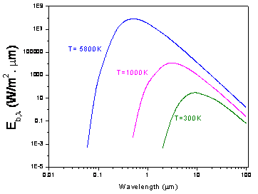
Thermal Radiation of an Ideal (Black) Body
Units

Slide 13

Thermal Radiation of an Ideal (Black) Body
Planck’s Law
Emitted radiation varies continuously
with wavelength
At any wavelength the magnitude of radiation increases with temperature
There is a relationship between the peak of emission and temperature

Slide 14
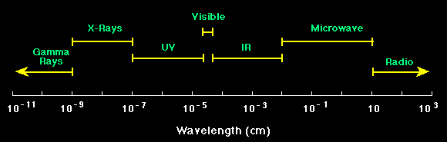
Thermal Radiation of an Ideal (Black) Body
Planck’s Law
Sun Temperature = 5,800K
(visible light)
Temperature = 800K
(infrared)

Slide 15
Thermal Radiation of an Ideal (Black) Body
Planck’s Law
Energy Emitted by a
Black Body at a given
All Energy Emitted by a Black Body
Stefan –Boltzmann’s Law
5.67x10⁻⁸ W/m².K⁴
Stefan –Boltzmann constant

Slide 16
Fraction of Energy Emitted by a Black
Body between two wavelengths

Slide 17
Fraction of Energy Emitted by a Black
Body between two wavelengths
By defining

Slide 18
Fraction of Energy Emitted by a Black
Body between two wavelengths
Table 8.2
0 | 0
200 | 7.010E-27
400 | 2.20179E-12
600 | 9.96926E-8
2000 | 0.0670396

Slide 19
Example: Calculate the fraction of Solar Energy
that is in the visible region 0.38μm-0.76μm
From Table 2 by interpolation
Fraction of Solar Energy in the visible region
= 0.5491-0.1013 = 0.4478 (44.8%)

Slide 20
Thermal Radiation from a Real Body
Ideal Black Body
T
Real Body
T
Define Total Emissivity

Slide 21
Typical Emissivities of Biomaterials
water
Biomaterials
All paints
Aluminum Oxidized
Aluminum polished
0.1
0.2
0.3
0.4
0.5
0.6
0.7
0.8
0.9
1.0

Slide 22
Concept of Gray Body
(ALSO AN IDEAL MATERIAL BUT THAT EMMITS/ABSORBS LESS ENERGY THAN THE BLACK BODY)
Monochromatic Emissivity
Wavelength (μm)
What assumption is used to consider a Gray Body as an ideal material ?
That the Monochromatic Emissivity is independent of the wavelength

Slide 23
Emission from Human Bodies
Microwave Thermography for Clinical Uses
Infrared
Microwave (high penetration)
Research
on new
detectors
of low radiation
Intensity

Slide 24
Review
Incident
Radiation
Reflected
Specular Reflection: Angle
of incidence is equal to angle
of reflection
Diffuse Reflection: Waves
are reflected in all direcctions
Absorbed
Transmitted
Reflectivity
Absorptivity
Transmissivity

Slide 25
Review of Previous Concepts
Black Body
5.67x10⁻⁸ W/m².K⁴
Real Body

Slide 26
MORE RADIACTIVE ENERGY
TRANSFER RADIATION
Describe relationships between body Emissivity and its energy absorption. Kirchhoff’s Law.
Define and characterize View Factors
Application problems

Slide 27
Kirchhoff’s Law
Enclosure (Black Body)
T_{S}
Steady State Conditions
Energy Balance for Body 1

Slide 28
Kirchhoff’s Law
Steady State Conditions
Energy Balance for Body 1
Energy Absorbed
by body A₁
Energy Emitted
by body A₁

Slide 29
Kirchhoff’s Law
Steady State Conditions
Energy Balance for Body 1
Using the same balance for each body

Slide 30
Kirchhoff’s Law
For an enclosure
We could gain much practical use if we could figure out
what’s required for

Slide 31
Kirchhoff’s Law
The energy balance on a per unit wavelength basis, can be calculated as:
If we also have either ε_{λ} = α_{λ}, or ε_{λ} and α_{λ} are independent of λ, then
Radiation between surfaces are greatly simplified
if the equation above may be applied

Slide 32
GRAY BODY/SURFACE
For a gray surface, the spectral emissivity e and absorptivity a of a given surface are independent of wavelength for the spectral region corresponding to emitted and incident radiation
Unless spectral regions of emission and irradiation are widely separated, the assumption of gray surface is widely used in practical applications

Slide 33
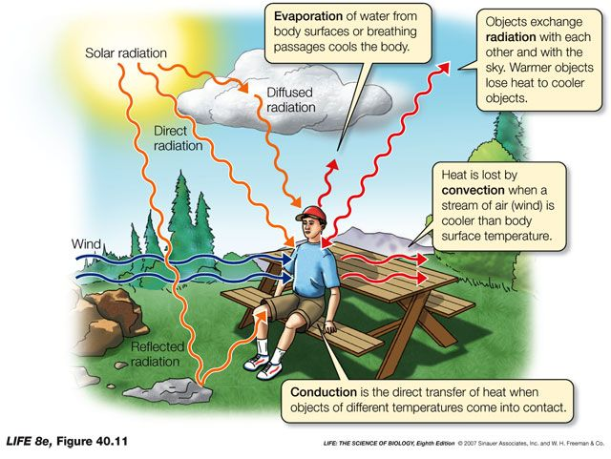
Concept of View Factors

Slide 34

Concept of View Factors

Slide 35
CONCEPTS ON SURFACE EMISSION
Ideal
Black
Body
Solid Angle
Real Surface
Emission of
Radiation
General case
Diffuse Emitter
These angles characterize
the surface and its emission

Slide 36
Engineering Simplifications
In general, we have:
For diffuse irradiation or for a diffuse surface, we have:
For irradiation from a black body or for a gray diffuse surface, we have:

Slide 37
View Factors
T₁
T₂
A₁
A₂
Net heat flow is a function of the size, shape, and
orientation of the radiant surfaces

Slide 38
View Factors – General Case
dA₂
Energy emitted and reflected
dA₁

Slide 39
View Factors – General Case
Way to calculate them

Slide 40
View Factors – General Case
Let’s assume that bodies 1 and 2 are black bodies
Net Heat Flow

Slide 41
View Factors – General Case
Net Heat Flow

Slide 42
View Factors
Infinite Parallel Black Planes

Slide 43
View Factors
Infinite Parallel Gray Planes (there is reflection
of energy)
Energy Emitted from Surface 1 to surface 2
Energy Absorbed by surface 2
Energy Reflected to surface 1
Energy Reflected back to surface 2
Energy absorbed by surface 2

Slide 44
View Factors
Infinite Parallel Gray Planes
Geometric Series

Slide 45
View Factors
Infinite Parallel Gray Planes

Slide 46
View Factors – Other Situations
Enclosure made of black surfaces all at
different temperatures
All surfaces are black bodies, n is the total number of surfaces
Two gray bodies exchanging radiation and forming
an enclosure
Surface 2
For parallel large gray surfaces and
Surface 1

Slide 47
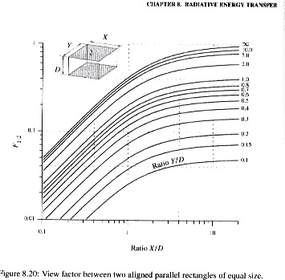
View Factors – Other Situations

Slide 48
SOME INFORMATION ON THE WEB

